Slide 1

CSE 489: Digital Image Processing
Topic – 4: Basic Image Processing Operations
Contents:
  Histogram Processing
  Convolution
  Filtering

Slide 2
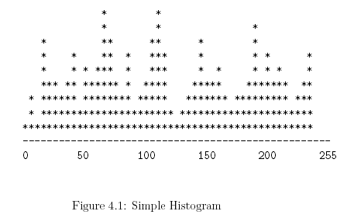

Histogram Processing
A histogram uses a bar graph to profile the occurrences of each gray level present in an image.
The horizontal axis is the gray-level values. It begins at zero and goes to the number of gray levels (256 in this example).
Each vertical bar represents the number of times the corresponding gray level occurred in the image.

Slide 3
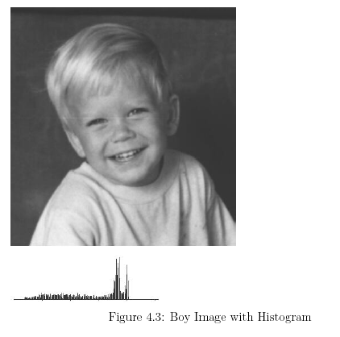
Histogram Processing

Slide 4
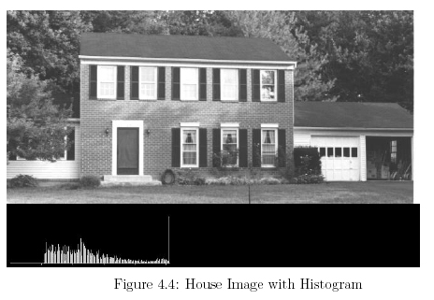
Histogram Processing

Slide 5
Histogram Processing: Histogram Equalization
The cure for low contrast images is histogram equalization.
Equalization causes a histogram with a mountain grouped closely together to “spread out” into a flat or equalized histogram.
Spreading or flattening the histogram makes the dark pixels appear darker and the light pixels appear lighter.

Slide 6

Histogram Processing: Histogram Equalization
Equation 4.1 represents the equalization operation, where c is an image with a poor histogram. The function f transforms the image c into an image b with a flat histogram.
Equation 4.2 shows the probability-density function of a pixel value a. p(a) is the probability of finding a pixel with the value a in the image. Area is the area or number of pixels in the image and H(a) is the value of histogram of the image at a.

Slide 7
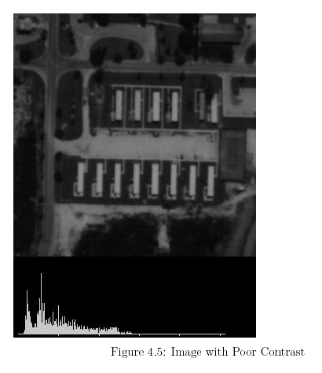
Histogram Processing: Histogram Equalization

Slide 8
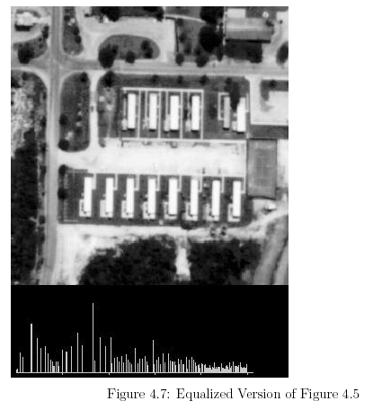
Histogram Processing: Histogram Equalization

Slide 9
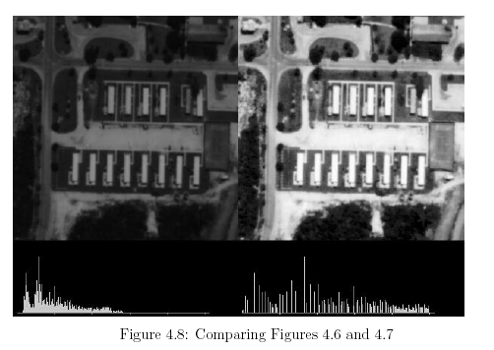
Histogram Processing: Histogram Equalization

Slide 10

Convolution
There are several possible notations to indicate the convolution of two (multi-dimensional) signals to produce an output signal. The most common are:
In 2D continuous space:

Slide 11
Filtering
Filtering is also a common concept.
High-pass filters pass high frequencies and stop low frequencies.
Low-pass filters stop high frequencies and pass low frequencies.
In the same manner, it is possible to filter spatial frequencies in images.
A high-pass filter will amplify or “pass” frequent changes in gray levels and a low-pass filter will reduce frequent changes in gray levels.

Slide 12
Filtering
Consider the nature of a frequent or sharp change in gray level.
Figure 7.1 shows an image with only one change in gray level. That change, however, was very sharp – it was an edge.
A high-pass filter will pass, amplify, or enhance the edge. A low-pass filter will try to remove the edge. Instead of an instant move from one gray level to another, the low-pass filter will produce a gradual slope between the two levels. The two gray levels will still exist, but the transition will be slower.

Slide 13
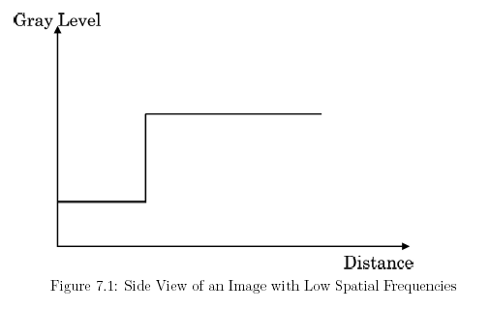
Filtering

Slide 14
Filtering: Application
Spatial image filtering has several basic applications in image processing. Among these are noise removal, smoothing, and edge enhancement.
Noise in an image usually appears as snow (white or black) randomly sprinkled over an image.
Spikes, or very sharp, narrow edges in the image cause snow. A low-pass filter smoothes and often removes these sharp edges.
Edge enhancement improves the appearance of an image by sharpening the outlines of objects.

Slide 15
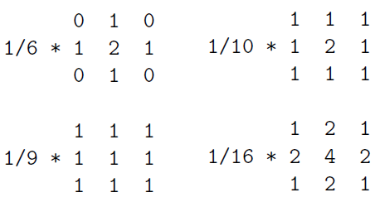
Filtering: Low-Pass Filtering
Low-pass filtering smoothes out sharp transitions in gray levels and removes noise.
Some low-pass filter convolution masks:

Slide 16
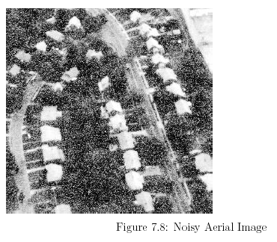
Filtering: Low-Pass Filtering

Slide 17
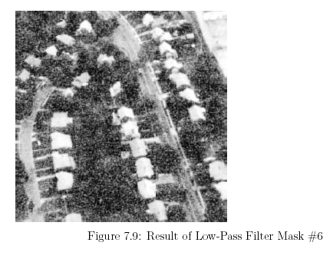
Filtering: Low-Pass Filtering

Slide 18
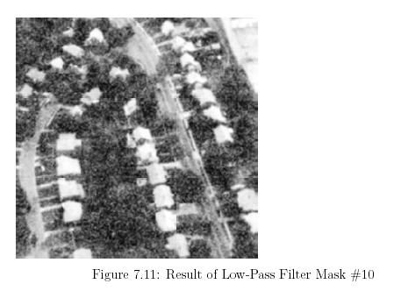
Filtering: Low-Pass Filtering

Slide 19
Filtering: Median Filters
A special type of low-pass filter is the median filter. The median filter takes an area of an image (3x3, 5x5, 7x7, etc.), looks at all the pixel values in that area, and replaces the center pixel with the median value. The median filter does not require convolution. It does, however, require sorting the values in the image area to find the median value.

Slide 20
Filtering: Median Filters
There are two noteworthy features of the median filter.
  It is easy to change the size of the median filter. (The images later will show the effect of using a different size.) Implementing the different size is a simple matter of changing for loops in the code.
  Median filters remove noise in images, but change noise-free parts of images minimally.

Slide 21
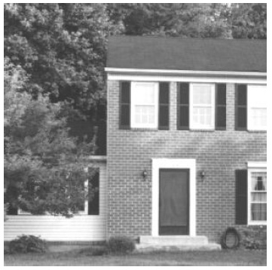
Filtering: Median Filters
House Image

Slide 22
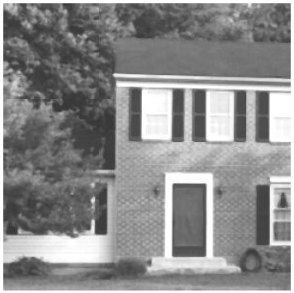
Filtering: Median Filters
Result of 3x3 Median Filter

Slide 23

Filtering: Median Filters
Result of 5x5 Median Filter

Slide 24

Filtering: Median Filters
Result of 7x7 Median Filter

Slide 25

Filtering: High-Pass Filtering
High-pass filters amplify or enhance a sharp transition (an edge) in an image.
Some high-pass filter convolution masks:

Slide 26
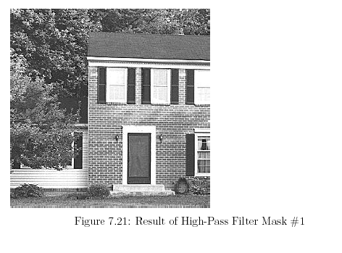
Filtering: High-Pass Filtering

Slide 27
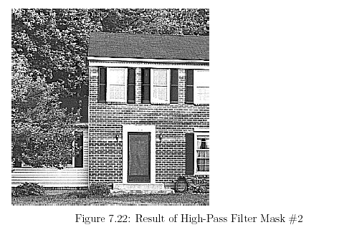
Filtering: High-Pass Filtering

